Slide 1
7. Write a Servlet program to store a user's preferences (like theme or language) using cookies. Retrieve and display these preferences on
subsequent visits.
AIM
To develop a Java Servlet-based web application that stores user preferences (such as theme and language) using cookies and retrieves them on subsequent visits to personalize the weather information webpage.
ALGORITHM
Create a Dynamic Web Project in Eclipse or any IDE.
Add Servlet API library (Apache Tomcat server).
Create an HTML form to accept user preferences: Theme (Light/Dark)
Language (English/Tamil/etc.)
Develop a Servlet (PreferenceServlet): Read user inputs from the form.
Store preferences using cookies.
Develop another Servlet (DisplayServlet): Retrieve cookies.
Display saved preferences along with weather info.
Configure web.xml (if not using annotations).
Run the project on server (Tomcat).
Test in browser:
First visit → set preferences.
Next visit → preferences auto-loaded.
SOURCE CODE
1. HTML Page (index.html)
<!DOCTYPE html>
<html>
<head>
<title>Weather Preferences</title>
</head>
<body>
<h2>Select Your Preferences</h2>
<form action="PreferenceServlet" method="post"> Theme:
<select name="theme">
<option value="Light">Light</option>
<option value="Dark">Dark</option>
</select>
<br><br>
Language:
<select name="language">

Slide 2
<option value="English">English</option>
<option value="Tamil">Tamil</option>
</select>
<br><br>
<input type="submit" value="Save Preferences">
</form>
<br>
<a href="DisplayServlet">View Weather Page</a>
</body>
</html>
PreferenceServlet.java
import java.io.; import javax.servlet.; import javax.servlet.http.*; public class PreferenceServlet extends HttpServlet {
protected void doPost(HttpServletRequest request, HttpServletResponse response) throws ServletException, IOException {
String theme = request.getParameter("theme"); String language = request.getParameter("language");
// Create cookies
Cookie themeCookie = new Cookie("theme", theme);
Cookie languageCookie = new Cookie("language", language);
// Set expiry time (1 day) themeCookie.setMaxAge(24 * 60 * 60);
languageCookie.setMaxAge(24 * 60 * 60);
// Add cookies to response response.addCookie(themeCookie); response.addCookie(languageCookie);
PrintWriter out = response.getWriter(); out.println("<html><body>"); out.println("<h3>Preferences Saved Successfully!</h3>");
out.println("<a href='DisplayServlet'>Go to Weather Page</a>"); out.println("</body></html>");
}
}
DisplayServlet.java
import java.io.*; import javax.servlet.*;
import javax.servlet.http.*;
public class DisplayServlet extends HttpServlet {
protected void doGet(HttpServletRequest request, HttpServletResponse response) throws ServletException, IOException {
Cookie cookies[] = request.getCookies();

Slide 3
String theme = "Not Set"; String language = "Not Set";
if (cookies != null) {
for (Cookie c : cookies) {
if (c.getName().equals("theme")) { theme = c.getValue();
}
if (c.getName().equals("language")) { language = c.getValue();
}
}
}
PrintWriter out = response.getWriter(); out.println("<html><body>");
// Apply theme
if (theme.equals("Dark")) {
out.println("<body style='background-color:black; color:white;'>");
}
out.println("<h2>Weather Information Page</h2>"); out.println("<p><b>Theme:</b> " + theme + "</p>"); out.println("<p><b>Language:</b> " + language + "</p>");
// Dummy weather info out.println("<h3>Today's Weather</h3>"); out.println("<p>Temperature: 32°C</p>"); out.println("<p>Condition: Sunny</p>");
out.println("<br><a href='index.html'>Change Preferences</a>"); out.println("</body></html>");
}
}
4. web.xml
<web-app>
<servlet>
<servlet-name>PreferenceServlet</servlet-name>
<servlet-class>PreferenceServlet</servlet-class>
</servlet>
<servlet-mapping>
<servlet-name>PreferenceServlet</servlet-name>
<url-pattern>/PreferenceServlet</url-pattern>
</servlet-mapping>
<servlet>
<servlet-name>DisplayServlet</servlet-name>
<servlet-class>DisplayServlet</servlet-class>
</servlet>

Slide 4
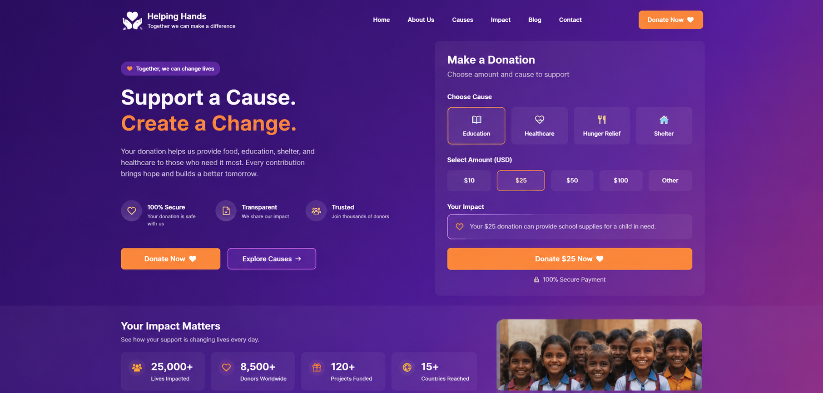
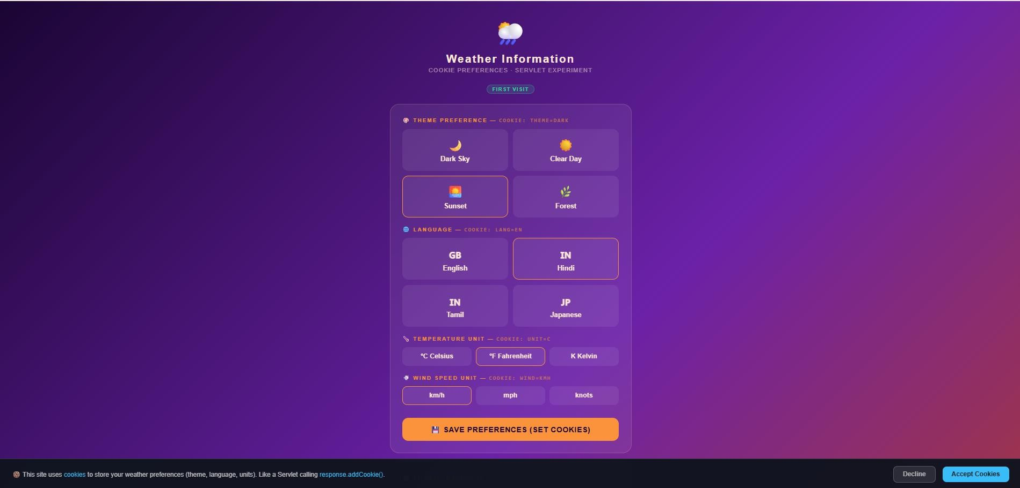
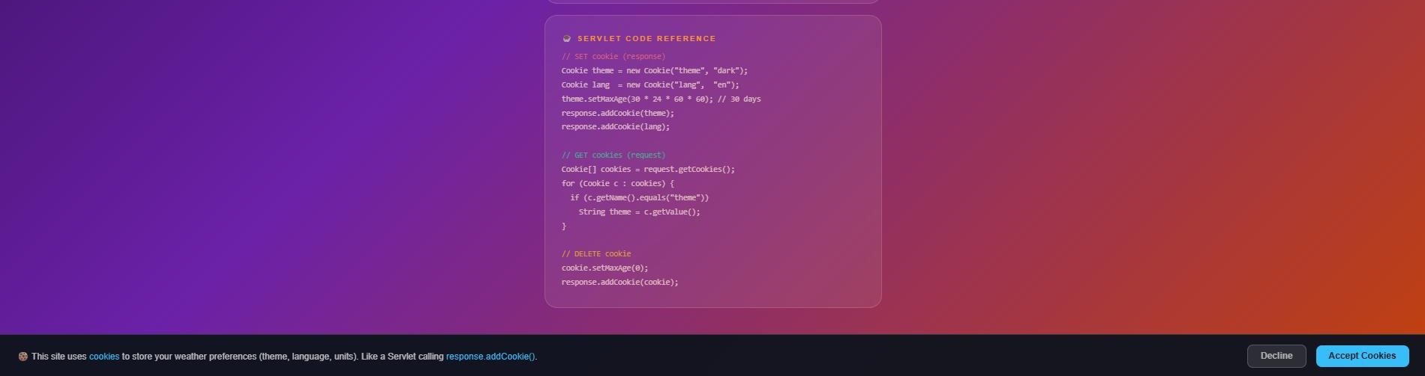
<servlet-mapping>
<servlet-name>DisplayServlet</servlet-name>
<url-pattern>/DisplayServlet</url-pattern>
</servlet-mapping>
</web-app>
OUTPUT :

Slide 5
Result:
The experiment was successfully completed.User preferences (theme and language) were stored using cookies and retrieved on subsequent visits, allowing the weather webpage to provide a personalized user experience.

